Slide 1
Analysis of E-sports Earnings
Natalia Phipps: (Project Lead)
Hugo S: (Visualization Expert)
Aron Lecznar : (Data Cleaning Expert)

Slide 2
Research Questions
Null Hypothesis: Player Country of origin has no bearing, positive or negative, on the amount of money a player is capable of earning in e-sports
Is there visual variability in the earnings each country makes?
Is there a relationship between the genre of game and how much a country earns?
Do certain video games have an impact on total earning?
Does the number of players in each country have an impact on total earning?
What is the relationship between country and total earning?
Notes:
Talk about the motivation behind the questions

Slide 3
Data Sources
Kaggle: e-sports earnings
2 CSV files used:
Highest_earning_players.csv
Country-and-continent-codes-list.csv
Dataset was taken from an pre-existing dataset on e-sports earnings from 1998-2020
Notes:
NOTE: Used Kaggle to find existing datasets on e-sports earnings, we found one dataset someone created using csv files from a larger dataset that contained esports financial data from 1998-2020.
We used two Csv files from the kaggle dataset: Highest Earning Players Csv and Country and Continent Codes list csv for our analysis

Slide 4
Data Exploration
Merged the two datasets
Cleaned Data
Broke down the data to help us answer the research questions
Game by USD
Prize by USD
Genre by USD
Average USD by Country
Amount of players in each country
Total USD the players earned

Slide 5
Analysis Process
Cleaned the dataset
Formulated summary tables to answer our certain research questions
Created visualizations to display the relationships in our dataset
Running ANOVA to find the p-value, did we fail to reject the null hypothesis

Slide 6
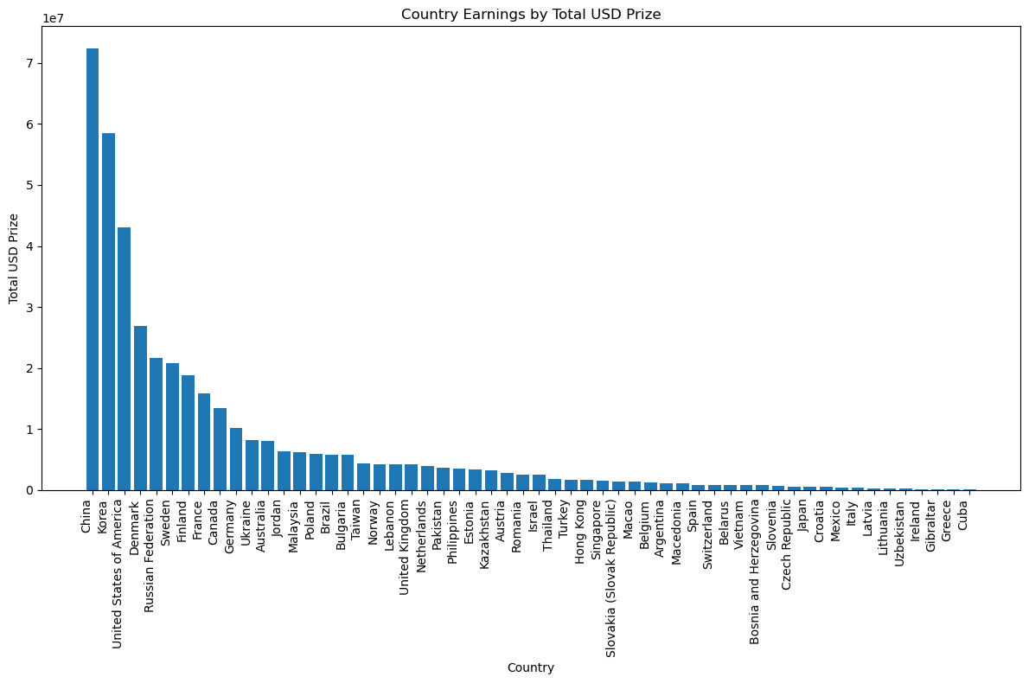
Question 1: Is there visual variability in the earnings each country makes?
Notes:
This bar chart shows the Total USD Prize by country. We can see that China, Korea, and the U.S had the highest total earnings compared to all other countries.

Slide 7
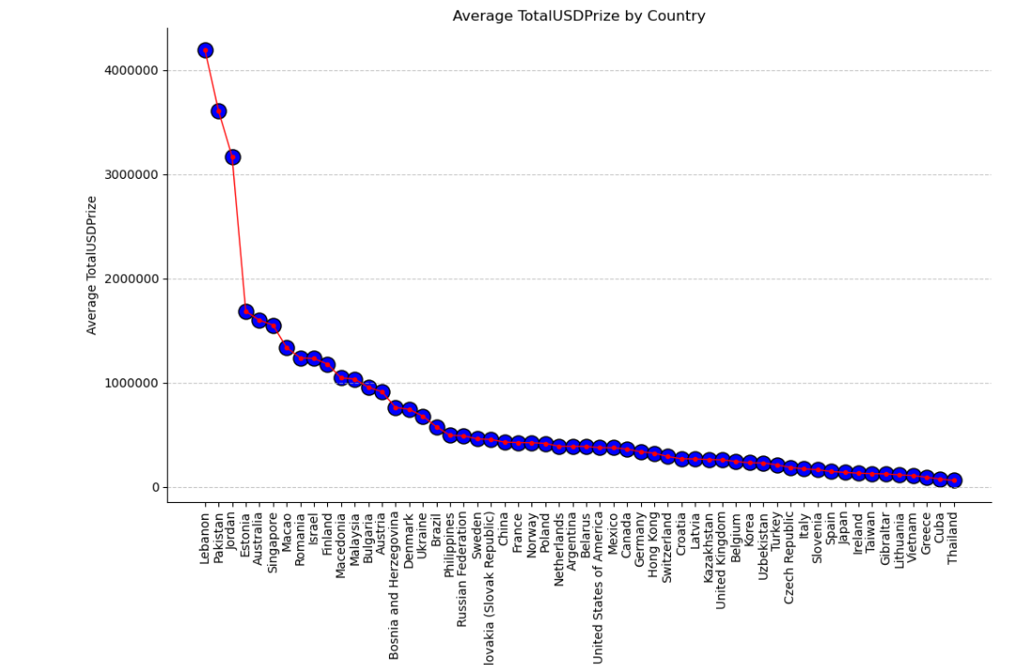
Average Total USD Prize
Notes:
We took the total earnings from each country and calculated the averages. We can see from this chart that when conducting averages, Lebanon, Pakistan, Jordan, and Estonia had the highest average earnings.

Slide 8
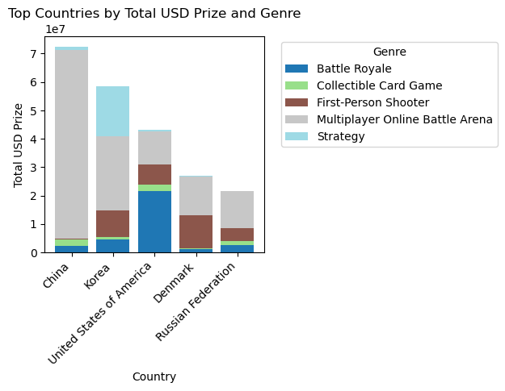
Question 2: Is there a relationship between the genre of game and how much a country earns?

Slide 9
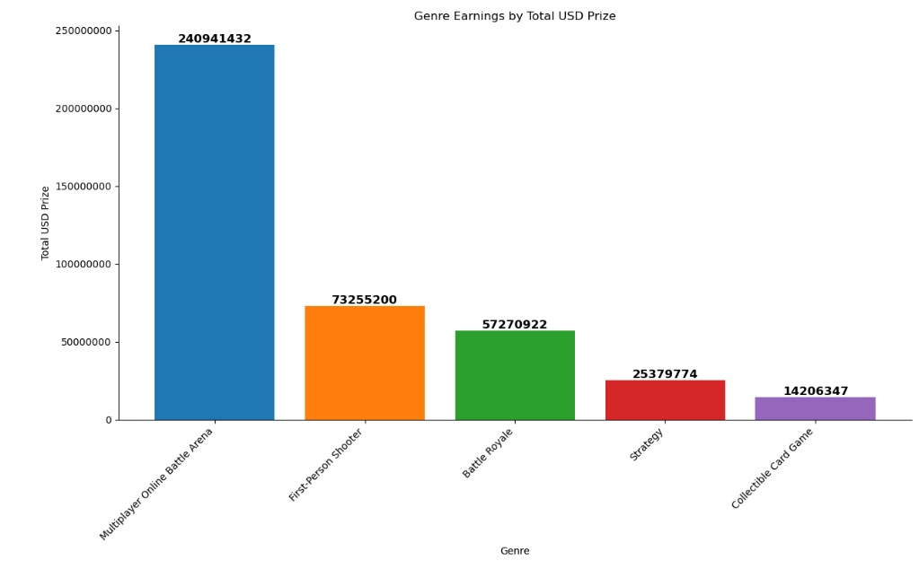
Genre Earnings Bar Chart

Slide 10
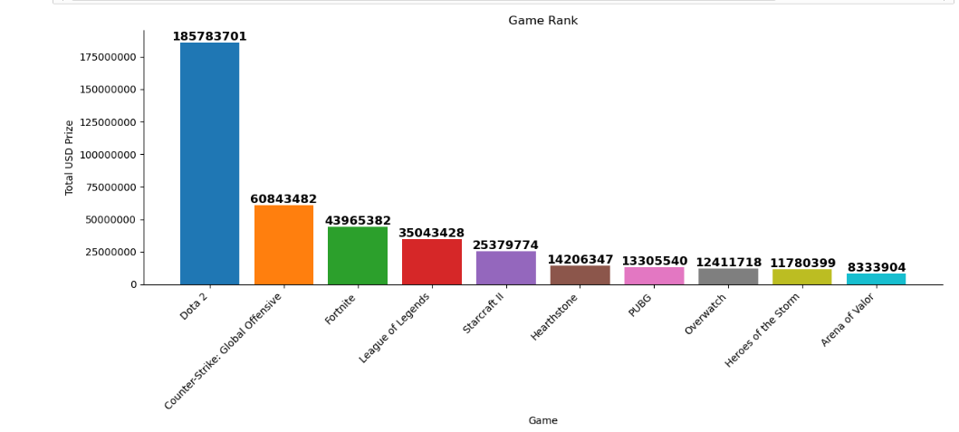
Question 3: Do certain video games have an impact on total earnings?

Slide 11
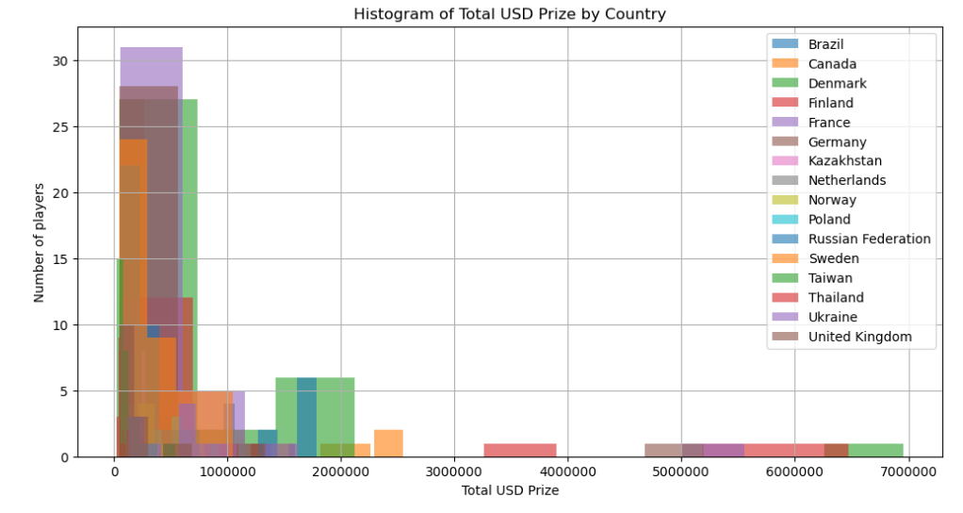
Question 4: Does the number of players in each country have an impact on total earnings?

Slide 12

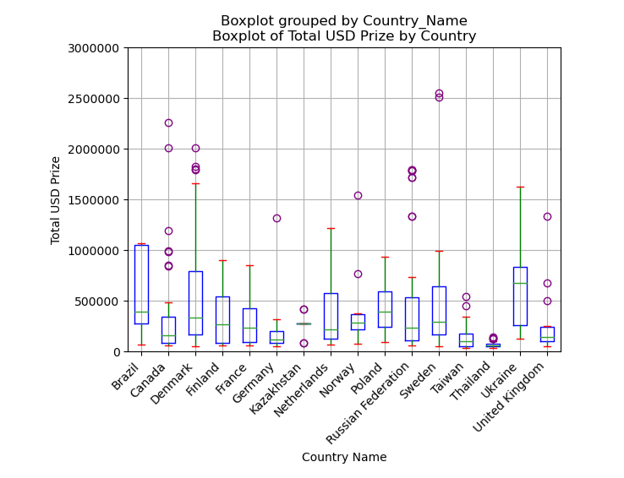
Question 5: What is the relationship between country and total earning?
Notes:
Note: boxplots are snipped of data

Slide 13
Conclusions
Do certain video games have an impact on total earning?
Yes, Dota 2 had the highest earnings compared to the other 9 games
Majority of players compete in Dota 2
Players that are the most dominant in e-sports industry compete in Dota2
Dota 2 has bigger funding
Is there visual variability in the earnings each country makes?
Yes, we can see from the visualization that China has the highest total earnings compared to the other countries
Esports industry may be very popular in china
China has a huge player count
Is there a relationship between the genre of game and how much a country earns?
Yes, genre has a big impact on total earnings
Multiplayer battle arena had the highest total earnings
Average Total Prize
Our bar chart revealed that Lebanon had the highest average in earnings
This could indicate that while the total earnings for Lebanon were comparatively smaller than other countries, the average earnings each player makes is greater.
Does the number of players in each country have an impact on total earning?
Yes, Surprisingly, countries with smaller player counts generated the highest earnings. This could mean that those players are dominant in the industry, or they frequently compete in esports.
What is the relationship between country and total earnings?
Our p-value came out to 0.001506 which lets us reject our null hypothesis.
The differences between country of origin and Total USD Prize was not due to chance

Slide 14
Implications
it appears that a player's country of origin does have an impact on their earnings in the esports industry.
Variables such as game genre, and player count also play significant roles in determining total earnings.
Popularity of the esports industry in those countries
Age of players in these countries
Tournaments
Funding
Dominant players country of origin
Future research and analysis could provide insights into how the esports industry could advertise to certain demographics where esports are popular.
Financing esports teams
Where to hold tournaments
Server location

